Slide 1
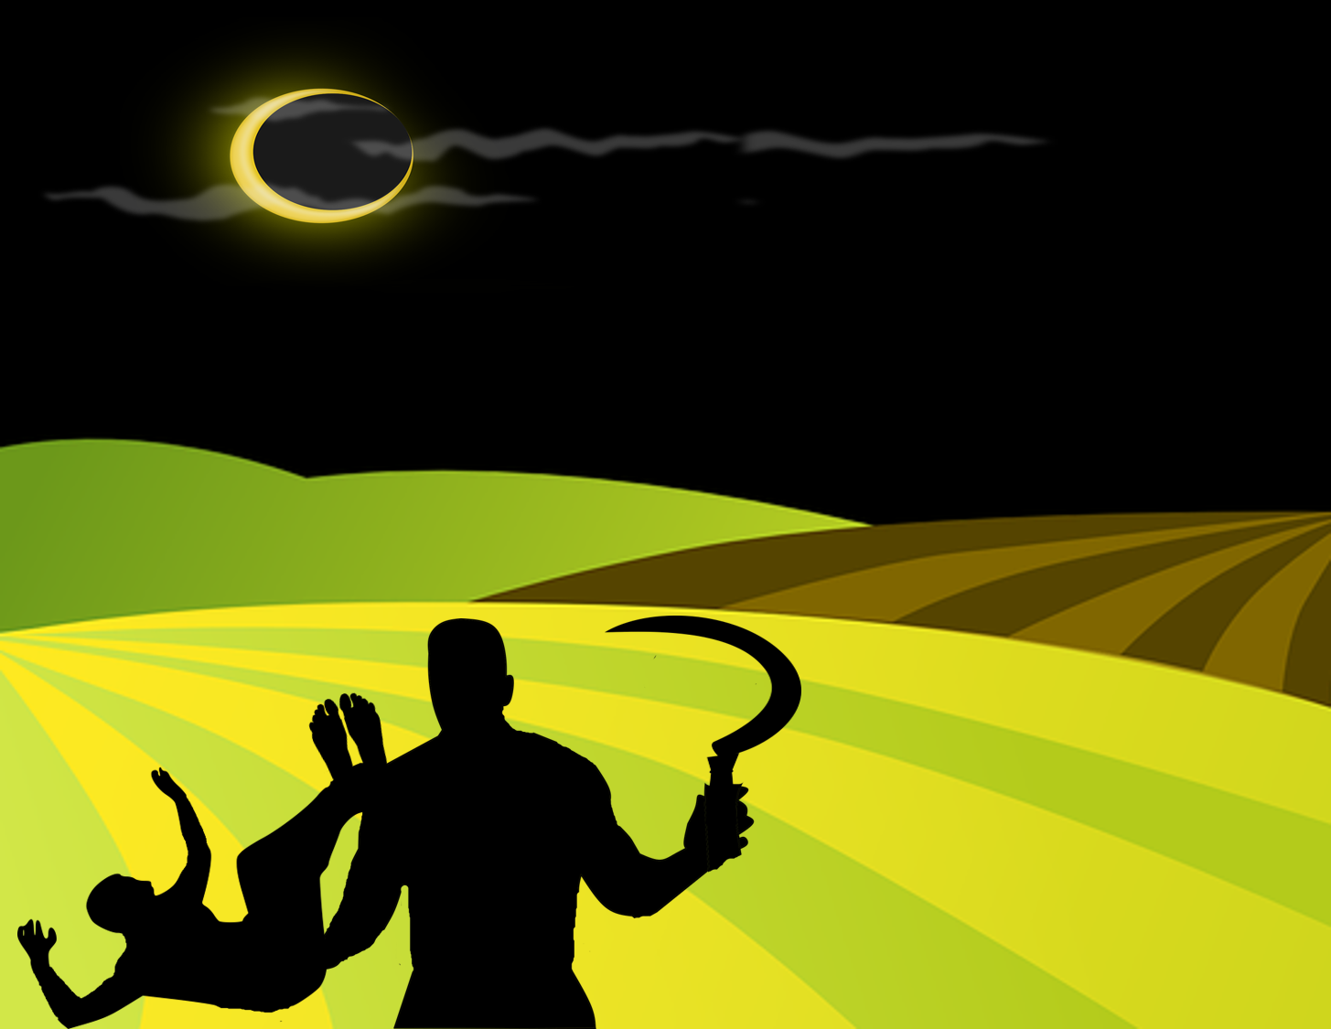
“A World Marred by Sin”
a study of Genesis 4 for evangelism
Genesis
4:1-7

Slide 2
A World Marred by Sin
Genesis 4:1-7
“Now Adam knew Eve his wife, and she conceived...” [v1]
⬧ This is further evidence that Adam and Eve accepted the punishment [cp 3:20]
- Eve said, “I have acquired a man from the Lord” [4:1; “Cain” sounds like “acquired”, Hb]
• she seems to be thinking of the promise as her first son is born; could this one be
THE seed? [cp Gen 3:15]
• cp Lamech’s similar consideration in Genesis 5:28-29 when Noah is born
Genesis 4

Slide 3
A World Marred by Sin
Genesis 4:1-7
“Now Adam knew Eve his wife, and she conceived...” [v1]
“Then she bore again, this time his brother Abel.” [v2]
⬧ Adam and Eve obey God’s command to “be fruitful and multiply” [cp Gn 1:28]
- “Now Abel was a keeper of sheep, but Cain was a tiller of the ground.” [v2]
• their sons, born into a world that has been cursed by sin, are soon recognized by the
hard labor they must do to produce what is needed for survival
Abel was a keeper of sheep: in a world marred by sin there was a need for clothing; with wool, there would be no need to kill the animal for clothes. [Meat isn’t given as food till Gn 9:2-4]
Cain was a tiller of the ground: just like his father Adam, Cain would have to work the hard and cursed earth, clearing thorns and thistles to provide food for his family.
Genesis 4

Slide 4
A World Marred by Sin
Genesis 4:1-7
“Now Adam knew Eve his wife, and she conceived...” [v1]
“Then she bore again, this time his brother Abel.” [v2]
“...Cain brought an offering... Abel also brought…” [vv3-4]
⬧ This is the first account of an external act of worship recorded in the Bible
- these men brought their “gifts” “to the Lord” [worship is “approaching” God; cp Lv 1:2]
- does what each man offers make sense?
They offered up the fruit of their own labors: this is all that they had to offer. It makes perfect sense. We must realize that God did not reveal (to us) what He expected as an offering from them; we cannot affirm that Cain’s error was offering grains.
Genesis 4

Slide 5
A World Marred by Sin
Genesis 4:1-7
“Now Adam knew Eve his wife, and she conceived...” [v1]
“Then she bore again, this time his brother Abel.” [v2]
“...Cain brought an offering... Abel also brought…” [vv3-4]
⬧ This is the first account of an external act of worship recorded in the Bible
- these men brought their “gifts” “to the Lord” [worship is “approaching” God; cp Lv 1:2]
- does what each man offers make sense?
- beyond material, any other differences?
Cain brought his offering ‘in the process of time’: there is a translational possibility here that this refers to the time after the reaping, once the farmer has all he wants. The rest given to God!?
Abel brought ‘of the firstborn’ and ‘of their fat’: he seems to have chosen the first and the best for an offering to the Lord, only then keeping the rest for himself.
Genesis 4

Slide 6
A World Marred by Sin
Genesis 4:1-7
“Now Adam knew Eve his wife, and she conceived...” [v1]
“Then she bore again, this time his brother Abel.” [v2]
“...Cain brought an offering... Abel also brought…” [vv3-4]
“And the Lord respected Abel and his offering, but…” [vv4-5]
⬧ Note Abel was respected by God, and therefore his gift was also accepted
- God looks first at the offerer , and then at the offering
- because God did not respect Cain, He also therefore did not respect his offering!
God is looking first for a relationship with His creation, and not just a transfer of goods! Religion teaches us that God is to be manipulated and pacified with good gifts; the Bible teaches us that God is seeking for “true worshipers” -- those who “will worship the Father in spirit and truth.” [John 4:23-24]
Genesis 4

Slide 7
A World Marred by Sin
Although God does not need the things
we offer Him (He can create as many sheep or grains or coins as He likes!), the gift reveals the heart of the giver – and it is that heart the Lord is seeking: “...they first gave themselves to the Lord, and then to us by the will of God.”
[2 Cor 8:5; cp Rm 12:1-2; Ps 40:6-8]
Genesis 4:1-7
“Now Adam knew Eve his wife, and she conceived...” [v1]
“Then she bore again, this time his brother Abel.” [v2]
“...Cain brought an offering... Abel also brought…” [vv3-4]
“And the Lord respected Abel and his offering, but…” [vv4-5]
⬧ Note Abel was respected by God, and therefore his gift was also accepted
- God looks first at the offerer , and then at the offering
- because God did not respect Cain, He also therefore did not respect his offering!
God is looking first for a relationship with His creation, and not just a transfer of goods! Religion teaches us that God is to be manipulated and pacified with good gifts; the Bible teaches us that God is seeking for “true worshipers” -- those who “will worship the Father in spirit and truth.” [John 4:23-24]
Genesis 4

Slide 8
A World Marred by Sin
Genesis 4:1-7
“Now Adam knew Eve his wife, and she conceived...” [v1]
“Then she bore again, this time his brother Abel.” [v2]
“...Cain brought an offering... Abel also brought…” [vv3-4]
“And the Lord respected Abel and his offering, but…” [vv4-5]
“And Cain was very angry, and his countenance fell.” [v5]
⬧ Cain felt rejected – and even more in seeing Abel’s gift be accepted
- Cain’s all-too-common reaction was to become visibly upset
Why be upset with God? Isn't He the One we are seeking with our gifts and our service? If He doesn't like our offering for some reason, the right thing to do is find out where WE ERRED, and try again!
Quite often our “worship” is really nothing more than selfishness. If things don't go the way we want, we become upset and seek for another "God" who will do things the way that pleases US!
Genesis 4

Slide 9
A World Marred by Sin
Cain's reaction is wrong, but very
common! As we study the Bible and discover
that our worship is not pleasing to God, the best thing to do is to learn from Him what He desires of us, repent of OUR error, ask His forgiveness, and go forward doing His will and
not our own...
Genesis 4:1-7
“Now Adam knew Eve his wife, and she conceived...” [v1]
“Then she bore again, this time his brother Abel.” [v2]
“...Cain brought an offering... Abel also brought…” [vv3-4]
“And the Lord respected Abel and his offering, but…” [vv4-5]
“And Cain was very angry, and his countenance fell.” [v5]
⬧ Cain felt rejected – and even more in seeing Abel’s gift be accepted
- Cain’s all-too-common reaction was to become visibly upset
Why be upset with God? Isn't He the One we are seeking with our gifts and our service? If He doesn't like our offering for some reason, the right thing to do is find out where WE ERRED, and try again!
Quite often our “worship” is really nothing more than selfishness. If things don't go the way we want, we become upset and seek for another "God" who will do things the way that pleases US!
Genesis 4

Slide 10
A World Marred by Sin
Genesis 4:1-7
“Now Adam knew Eve his wife, and she conceived...” [v1]
“Then she bore again, this time his brother Abel.” [v2]
“...Cain brought an offering... Abel also brought…” [vv3-4]
“And the Lord respected Abel and his offering, but…” [vv4-5]
“And Cain was very angry, and his countenance fell.” [v5]
“So the Lord said to Cain, ‘Why are you angry?’...” [v6]
⬧ The Lord’s absolute goodness is remarkable! God asks the right questions…
- God wants Cain to consider his own reasons
We generally want to do the right thing. It can be frustrating to know that we haven't done as well as we thought we were doing. So God brought Himself to Cain's side to help him reach a solution.
God gives the solution: “If you do well, will you not be accepted?” [4:7; He doesn’t even mention the offering: He wants Cain himself !!]
Genesis 4

Slide 11
A World Marred by Sin
In order for Cain to “do well”, it would be necessary for him to know what God wants. From the context, we see that Abel did well (he was accepted). Heb 11:4 tells us: “By faith Abel offered to God a more excellent sacrifice than Cain...”. Since “faith comes by hearing” [see Rom 10:17], we can conclude that Abel offered that which he had heard from God.
Genesis 4:1-7
“Now Adam knew Eve his wife, and she conceived...” [v1]
“Then she bore again, this time his brother Abel.” [v2]
“...Cain brought an offering... Abel also brought…” [vv3-4]
“And the Lord respected Abel and his offering, but…” [vv4-5]
“And Cain was very angry, and his countenance fell.” [v5]
“So the Lord said to Cain, ‘Why are you angry?’...” [v6]
⬧ The Lord’s absolute goodness is remarkable! God asks the right questions…
- God wants Cain to consider his own reasons
We generally want to do the right thing. It can be frustrating to know that we haven't done as well as we thought we were doing. So God brought Himself to Cain's side to help him reach a solution.
God gives the solution: “If you do well, will you not be accepted?” [4:7; He doesn’t even mention the offering: He wants Cain himself !!]
Genesis 4

Slide 12
A World Marred by Sin
Genesis 4:1-7
“Now Adam knew Eve his wife, and she conceived...” [v1]
“Then she bore again, this time his brother Abel.” [v2]
Simply by not doing well, even if we are not seeking to do evil, we are already in the company of sin!
“...Cain brought an offering... Abel also brought…” [vv3-4]
“And the Lord respected Abel and his offering, but…” [vv4-5]
“And Cain was very angry, and his countenance fell.” [v5]
“So the Lord said to Cain, ‘Why are you angry?’...” [v6]
“And if you do not do well, sin lies at the door...” [v7]
At issue here is not just the right or wrong way to worship God: behind it all is the question of the desire to obey...or not to obey!
The problem that Cain faces is much graver than he realizes: if he does not “do well”, listening to and accepting God's word in all things, “sin lies at the door.” We like to think of sin as far away; it is not!
Genesis 4

Slide 13
A World Marred by Sin
Genesis 4:1-7
“Now Adam knew Eve his wife, and she conceived...” [v1]
“Then she bore again, this time his brother Abel.” [v2]
The idea that man is just some evolved ‘animal’ who “cannot help himself” but must satisfy his ‘animal urges’ is foreign to what God has revealed to us!
“...Cain brought an offering... Abel also brought…” [vv3-4]
“And the Lord respected Abel and his offering, but…” [vv4-5]
“And Cain was very angry, and his countenance fell.” [v5]
“So the Lord said to Cain, ‘Why are you angry?’...” [v6]
“And if you do not do well, sin lies at the door...” [v7]
⬧ “...its desire is for you, but you should rule over it.” [v7]
- cp this phrase with what God told the woman in Gen 3:16
- it is a question of ‘government’; man was not made to be
‘governed’ by sin, but rather should be disciplined against it!
Genesis 4

Slide 14
A World Marred by Sin
Genesis 4:8-12
“Now Cain talked with Abel his brother...” [v8]
⬧ The word “brother” appears 6 times in 4 verses here, 7 times since verse 4:1!
- Cain’s sin is heinous, unnatural; it demonstrates just how far from reason sin takes man
• the second most intimate degree of relationship possible on earth is severed by sin!
• Cain’s lack of faith, his envy, his murder and his “way” are his legacy throughout all
Bible history, as a warning… [cp Heb 11:4; 1 John 3:12; Jude 11]
Genesis 4

Slide 15
A World Marred by Sin
Genesis 4:8-12
“Now Cain talked with Abel his brother...” [v8]
⬧ The word “brother” appears 6 times in 4 verses here, 7 times since verse 4:1!
⬧ Being “brothers”, Abel had no reason to mistrust Cain as they talked
- “…it came to pass…that Cain rose up against Abel his brother and killed him” [v8]
• Cain met Abel “in the field”, where they both worked; still no suspicions
• Just a few short pages back in the history of the world we were in God's paradise in
the garden of Eden. Now a man has risen up to murder his own brother! We should
never allow ourselves to imagine that sin is something simple - in fact, God makes it
abundantly clear that sin always walks hand in hand with death !
Genesis 4

Slide 16
A World Marred by Sin
Genesis 4:8-12
“Now Cain talked with Abel his brother...” [v8]
“Then the Lord said to Cain, ‘Where is Abel your brother?’” [v9]
⬧ It should impress us how God is always near : as soon as Cain had finished
his horrible work, the Lord arrived with some questions for him...
- Again God brings a question that is seeking to raise a confession from Cain – after all,
this time it is beyond all doubt that God knows where Abel is, as we see in 4:10
- It is an interesting point that even though God is near, and even though He respected
Abel, God did not interfere to keep Cain from killing Abel.
God instructed and encouraged Cain to do well, but in the end it was Cain's decision. Both the just and the unjust suffer in this marred world because of the consequences of other peoples' sins and their own...
Genesis 4

Slide 17
A World Marred by Sin
Genesis 4:8-12
“Now Cain talked with Abel his brother...” [v8]
“Then the Lord said to Cain, ‘Where is Abel your brother?’” [v9]
⬧ It should impress us how God is always near : as soon as Cain had finished
his horrible work, the Lord arrived with some questions for him...
⬧ Cain answered, “I do not know. Am I my brother’s keeper?” [v9]
- Cain's arrogant response shows in two ways just how hardened his heart has already
become because of his sin...
(1) He lies to God's face! He knows exactly where Abel is...he is the one who just killed him! Cain no longer has any fear of God!
(2) Just as his parents had done, he blames God! “Am I my brother's keeper?” [“Isn't that Your job oh, Lord? If something has happened to Abel it's on You!”]
Genesis 4

Slide 18
A World Marred by Sin
Genesis 4:8-12
“Now Cain talked with Abel his brother...” [v8]
“Then the Lord said to Cain, ‘Where is Abel your brother?’” [v9]
“And He said, ‘What have you done?’” [v10]
⬧ This is no longer a search for answers, but an “enough!” moment
- God, in His longsuffering has already
(1) given instruction so that Cain could “do well”;
(2) come close to help him consider his attitude, hoping to encourage
a change before it’s too late; and
(3) offered yet another opportunity for Cain to confess his sin and to
seek the path of return to God. Cain rejected these opportunities
given by God’s grace; now, enough!
Genesis 4

Slide 19
A World Marred by Sin
Genesis 4:8-12
“Now Cain talked with Abel his brother...” [v8]
“Then the Lord said to Cain, ‘Where is Abel your brother?’” [v9]
“And He said, ‘What have you done?’” [v10]
⬧ This is no longer a search for answers, but an “enough!” moment
⬧ “The voice of your brother’s blood cries out to Me from the ground” [v10]
- Before announcing punishment on unjust Cain, God declares something interesting
about righteous Abel:
Together with the first death in the Bible, we get the first glimpse of hope for life after this one: God declares that in some way Abel still communicates with Him. Heb 11:4 says Abel, through faith, “being dead, still speaks.” The faithful (who “do well” and “live by faith”) have a relationship with God even after the physical body has died! [cp Rv 6:9-10; etc]
Genesis 4

Slide 20
A World Marred by Sin
Genesis 4:8-12
“Now Cain talked with Abel his brother...” [v8]
“Then the Lord said to Cain, ‘Where is Abel your brother?’” [v9]
“And He said, ‘What have you done?’” [v10]
“So now you are cursed from the earth…” [v11]
⬧ God now curses Cain himself, just as He had cursed the serpent [cp 3:14]
- Cain has shown himself to be “seed” of the serpent; therefore receives the same curse
- all who insist on disobeying the voice of God are doomed to the same fate...
Genesis 4

Slide 21
A World Marred by Sin
Genesis 4:8-12
“Now Cain talked with Abel his brother...” [v8]
“Then the Lord said to Cain, ‘Where is Abel your brother?’” [v9]
“And He said, ‘What have you done?’” [v10]
“So now you are cursed from the earth…” [v11]
⬧ God now curses Cain himself, just as He had cursed the serpent [cp 3:14]
⬧ As a result of this curse, the earth, which was already hardened and thorny,
will not “yield its strength” to Cain, no matter how hard he works! [v12]
- It is a double curse : cursed hands working in a cursed earth are
useless! Cain will become “a fugitive and a vagabond”
- In 4:16, we’ll see God’s curse did not include the “fugitive” aspect;
He speaks prophetically, knowing Cain will not accept correction
Genesis 4

Slide 22
What a blessing that God does not think as man does!
A World Marred by Sin
The Longsuffering Grace of God
In God's place, WHAT WOULD YOU HAVE DONE?
Why did God not simply kill Cain? Cain more than deserves death;
after all, he killed Abel, a good and righteous person that was pleasing to God...
Genesis 4

Slide 23
What a blessing that God does not think as man does!
A World Marred by Sin
The Longsuffering Grace of God
In God's place, WHAT WOULD YOU HAVE DONE?
Why did God not simply kill Cain? Cain more than deserves death;
after all, he killed Abel, a good and righteous person that was pleasing to God...
If the earth will no longer yield to him, where can Cain get food?
(1) In the bushes, among thorns. God provides food for the animals, which do not till and cultivate. It would be humbling for the ex-farmer to have to find his food in the bush and eat like an animal, but even in this God is good. (This is similar to the serpent's curse, in which he was humbled to “eat dust” instead of the green herb... [cp Gen 3:14])
Genesis 4

Slide 24
What a blessing that God does not think as man does!
A World Marred by Sin
The Longsuffering Grace of God
In God's place, WHAT WOULD YOU HAVE DONE?
Why did God not simply kill Cain? Cain more than deserves death;
after all, he killed Abel, a good and righteous person that was pleasing to God...
If the earth will no longer yield to him, where can Cain get food?
(1) In the bushes, among thorns. [cp Gen 3:14]
(2) From other people, far from Adam's family. He would need to steal from others or perform some service for them in order to receive his pay in food. [we will see that this will end up being his choice, which will make him become "a fugitive and a vagabond"... (cp Gen 4:12)]
Genesis 4

Slide 25
What a blessing that God does not think as man does!
A World Marred by Sin
The Longsuffering Grace of God
In God's place, WHAT WOULD YOU HAVE DONE?
Why did God not simply kill Cain? Cain more than deserves death;
after all, he killed Abel, a good and righteous person that was pleasing to God...
If the earth will no longer yield to him, where can Cain get food?
(1) In the bushes, among thorns. [cp Gen 3:14]
(2) From other people, far from Adam's family. [cp Gen 4:12]
(3) From his father. Adam is still alive and because of sin is a tiller of the ground. But Cain would have to confess his sin and ask forgiveness of his parents for having killed their son, his brother. But this possibility would bring him back toward the path of fellowship with God... [cp Gen 4:7]
Genesis 4

Slide 26
What a blessing that God does not think as man does!
A World Marred by Sin
The Longsuffering Grace of God
In God's place, WHAT WOULD YOU HAVE DONE?
Why did God not simply kill Cain? Cain more than deserves death;
after all, he killed Abel, a good and righteous person that was pleasing to God...
If the earth will no longer yield to him, where can Cain get food?
(1) In the bushes, among thorns. [cp Gen 3:14]
(2) From other people, far from Adam's family. [cp Gen 4:12]
If God had killed Cain
from the beginning, it would
have taken away his opportunity for repentance leading to forgiveness but that is not what God desires!
[cp Ezekiel 33:11]
(3) From his father. [cp Gen 4:7]
Genesis 4

Slide 27
A World Marred by Sin
Genesis 4:13-16
“...My punishment is greater than I can bear!” [v13]
⬧ Cain’s reaction is very different from Adam and Eve’s acceptance
- Cain does not accept his punishment, but complains to God He is too harsh and unfair
• in the midst of such incredible grace, Cain continues to act as a fool [cp Pv 15:5; etc]
• Cain’s focus continues to be on himself and his own desires: in his complaint in
Gen 4:13-14, Cain uses “My”, “I”, and “me” a total of seven times together!
Genesis 4

Slide 28
A World Marred by Sin
Genesis 4:13-16
“...My punishment is greater than I can bear!” [v13]
“Surely You have driven me out...” [v14]
⬧ Cain blames God for all the terrible things that he is about to suffer
- However, as he complains he ends up revealing the one who is truly to blame!
• “I shall be hidden from Your face” [cp Isaiah 59:2; hidden is the same word]
Truth is, God didn’t command any of this… it is Cain’s sin and his lack of repentance that cause these horrible conditions…
• “I shall be a fugitive and a vagabond” [cp 4:16 – “Cain went out...”]
Genesis 4

Slide 29
God has shown incredible compassion to us!
Jesus gave His life for us, while we were yet sinners!
[Romans 5:8]
Would you repent and give your life to Him?
A World Marred by Sin
Genesis 4:13-16
“...My punishment is greater than I can bear!” [v13]
“Surely You have driven me out...” [v14]
⬧ Cain blames God for all the terrible things that he is about to suffer
⬧ “...it will happen that anyone who finds me will kill me” [v14]
- As Cain is making his excuses and complaints, he stumbles upon a fearful concern!
• Sin carries with it the fear of death [cp Gen 2:17; Heb 2:14-15; Rom 6:23; etc]
- interestingly, up to this point it is only Cain who knows about murder! [cp Prov 28:1]
• Even in this, God continues to show absolute patience and mercy; though Cain
accuses Him of being too harsh and blames Him for his awful
condition, God offers compassion to protect him from evil! men...
WHY would God show compassion to such a horrible person? Because God is not like man! Instead, “The Lord is not slack concerning His promise... but is longsuffering toward us, not willing that any should perish but that all should come to repentance.” [2 Peter 3:9]
Genesis 4

