Slide 1
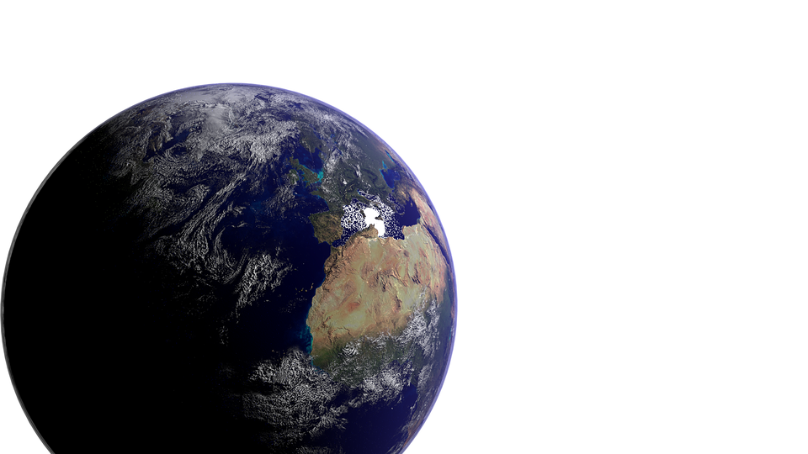
“The Nature of God”
a study of Genesis 1 for evangelism
part two:
“A God of Order”
Genesis
1:6-25

Slide 2
The Nature of God
Genesis 1:6-13
“Let there be a firmament…” [v6]
⬧ God speaks, God “divides”, and God names again
- “...God called the firmament Heaven” [v8]
Genesis 1

Slide 3

The Nature of God
The “Heavens”
The Bible speaks of three “heavens”:
“Heaven” [Gn 1:6]
- the blue sky, covered by clouds and filled with an atmosphere
to sustain the breath of terrestrial beings
- the dwelling-place of birds: cp Genesis 1:6-8, 20;
see also Psalm 8:8; etc
Genesis 1

Slide 4
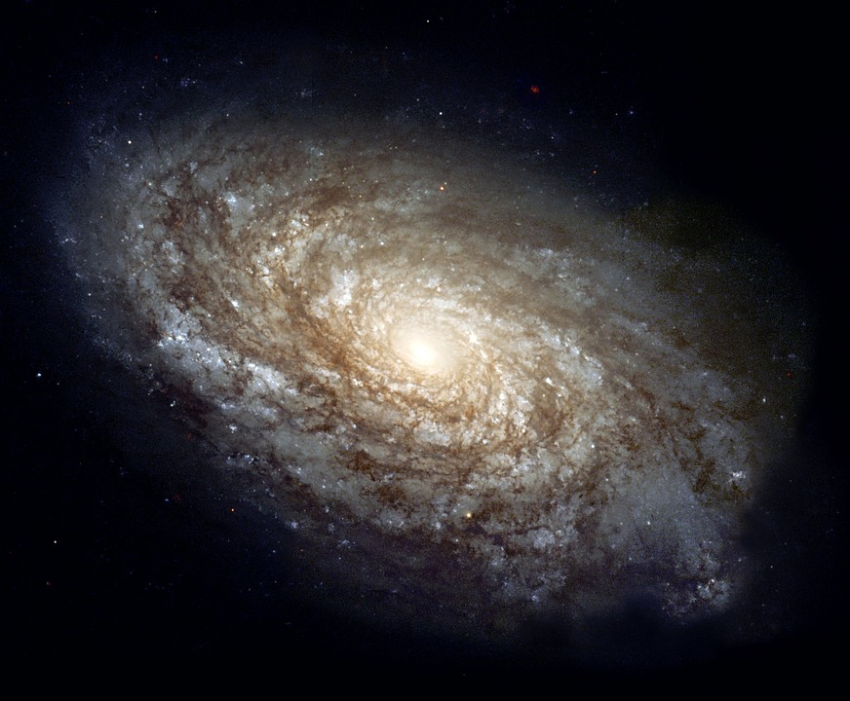
The Nature of God
The “Heavens”
The Bible speaks of three “heavens”:
“Heaven” [Gn 1:6]
The “heavens”:
- the rest of the physical universe that lies
beyond earth’s atmosphere; outer space
- the ‘home’ of the planets and the stars:
cp Genesis 1:14-16; Psalm 19:1; etc
Genesis 1

Slide 5
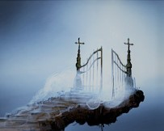
The Nature of God
The “Heavens”
The Bible speaks of three “heavens”:
The “third heaven”
or “heaven of heavens”:
“Heaven” [Gn 1:6]
The “heavens”:
All of the heavens were made by God:
Deuteronomy 10:14
- God’s “dwelling-place”:
see Rev 4:1; 12:7-9; and
cp 2 Corinthians 12:2-4;
1 Kings 8:27; Neh 9:6
Genesis 1

Slide 6


The Nature of God
Genesis 1:6-13
“Let there be a firmament…” [v6]
⬧ God speaks, God “divides”, and God names again
- “...God called the firmament Heaven” [v8]
• this firmament would “divide the waters from the waters” [v6]
• a division of waters “under the firmament” from waters “above the firmament” [v7]
- this is the creation of the water cycle, an atmosphere; a covering layer of clouds separated
from an enormous ocean by means of the sky [cp 2 Peter 3:5-7]
“waters...above the firmament”
“Heaven” = sky, atmosphere
“waters...under the firmament”
Genesis 1

Slide 7

The Nature of God
Genesis 1:6-13
“Let there be a firmament…” [v6]
“Let the waters...be gathered together into one place...” [v9]
“...and let the dry land appear” [v9]
- “And God called the dry land Earth” [v10]
“and...the waters He called Seas” [v10]
• the language here does not exclude
the possibility of an original super-
continent (“Pangaea”; et al)
Genesis 1

Slide 8
The Nature of God
When God divides light (“Day”) from darkness (“Night”) [1:4-5],
and the waters below from the waters above the firmament [1:6-7],
and the Seas from the dry land of Earth [1:9-10],
He shows
He is a God of order; His powerful word ordains things,
placing form where before there was only chaos...
Darkness
Light
Genesis 1

Slide 9
The Nature of God
A God of Order
The commandments of the Creator give order to (ordain, organize) the creation
“And the LORD God commanded (Hb ‘tsavah’; order, divinely ordain) the man, saying, ‘Of every tree of the garden you may freely eat; but of the tree of the knowledge of good and evil you shall not eat...’” Genesis 2:16-17
“You shall observe My judgments and keep My ordinances, to walk in them: I am the LORD your God.” Leviticus 18:4
“Now concerning the collection for the saints, as I have given orders to the churches of Galatia, so you must do also...”
1 Corinthians 16:1
“Let all things be done decently and in order.”
1 Corinthians 14:40
Genesis 1

Slide 10






The Nature of God
A God of Order
If God’s word is so powerful
and is meant to bring order,
then why do we see so much DISORDER?
Genesis 1

Slide 11
The Nature of God
A God of Order
The commandments of the Creator give order to (ordain, organize) the creation
Disorder is the result of disobedience to the Creator’s orders
“Because you have heeded the voice of your wife, and have eaten from the tree of which I commanded you …cursed is the ground for your sake” Genesis 3:17
“Then Nadab and Abihu, the sons of Aaron, each took his censer and put fire in it, put incense on it, and offered profane fire before the LORD, which He had not commanded them. So fire went out from the LORD and devoured them, and they died before the LORD.” Leviticus 10:1-2
Multiply this
by 7.3 billion people on earth today (or by all who have ever lived and sinned!) It would be just what we see:
chaos!
“But we command you, brethren…that you withdraw from every brother who walks disorderly...” 2 Thessalonians 3:6
“Sodom and Gomorrah… having given themselves over to sexual immorality… are set forth as an example, suffering the vengeance of eternal fire....” Jude 7
Genesis 1

Slide 12


The Nature of God
Genesis 1:6-13
“Let there be a firmament…” [v6]
“Let the waters...be gathered together into one place...” [v9]
“...and let the dry land appear” [v9]
“Let the earth bring forth grass,
The God of order establishes a natural law to govern the reproduction of plant species
the herb that yields seed,
and the fruit tree that yields fruit...” [v11]
- “…whose seed is in itself
according to its kind ” [v12]
A law so efficient we will see it again!
Genesis 1

Slide 13
The Nature of God
Consider what we learn of God’s nature from His account of the creation
God is ETERNAL (a uniquely Divine trait) [1:1]
God is SPIRIT (He is not physical, He is not like man) [1:2]
God’s creative power resides in HIS WORD [1:3]
God is GOOD (it is impossible for Him to think or to act by evil) [1:4]
God is HOLY (He is separate from creation; His nature is to sanctify) [1:4]
✓ God is a GOD OF ORDER (disobedience to his word brings disorder) [1:6-9]
Genesis 1

Slide 14



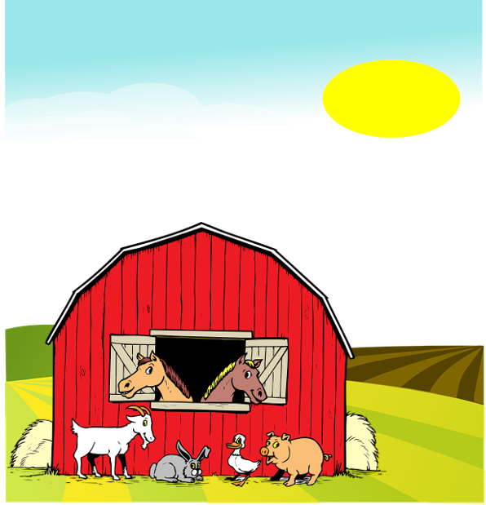

The Nature of God
Genesis 1:14-19
“Let there be lights in the firmament of the heavens...” [v14]
⬧ “...to divide the day from the night” [v14]
“...let them be for signs ” [v14]
- didn’t God already do this? [vv4-5]
SIGN (noun):
1. a token; indication.
2. any object, action, event, pattern,
etc., that conveys a meaning.
[Dictionary.com]
- who needs signs and is
able to understand them?
Plants?
God?
Animals?
Genesis 1

Slide 15
The Nature of God
“…let them be for signs”
Sometimes the Lord literally uses heavenly bodies as indicators
“The heavens declare the glory of God; And the firmament shows His handiwork. ...In them He has set a tabernacle for the sun...” Psalm 19:1, 4 (heavens = God exists)
“Now after Jesus was born in Bethlehem of Judea… wise men from the East came to Jerusalem, saying, ‘Where is He who has been born King of the Jews? For we have seen His star in the East and have come to worship Him.’” Matthew 2:1-2
(an actual heavenly body indicated where the Christ was born)
“Now from the sixth hour until the ninth hour there was darkness over all the land.” Matthew 27:45 (some special heavenly event [not an eclipse!] indicated God’s wrath over sin)
cp also Joshua’s “long day” [Joshua 10:11-14]; Hezekiah’s request that the sun go backward “ten degrees” [2 Kg 20:1-11; Isaiah 38:7-8] (God’s power over creation is clearly indicated)
Genesis 1

Slide 16

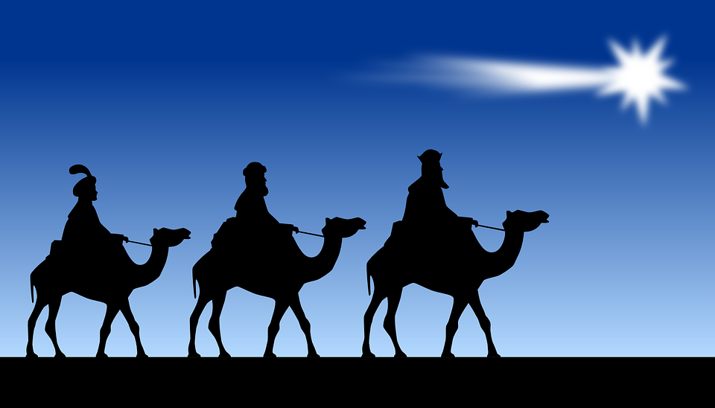


The Nature of God
Genesis 1:14-19
“Let there be lights in the firmament of the heavens...” [v14]
⬧ “...to divide the day from the night” [v14]
“...let them be for signs ” [v14]
- didn’t God already do this? [vv4-5]
⬧ “seasons...days and years” [v14]
- who needs signs and is
able to understand them?
⬧ “...let them be for lights” [v15, 17]
God made these things (and all things!) thinking of man (me and you!) before there was ever any man on the earth!
- does the eternal God need
to mark passing of time?
- does God need the light to see?
Day
Signs
Light
Night
Time
Genesis 1

Slide 17
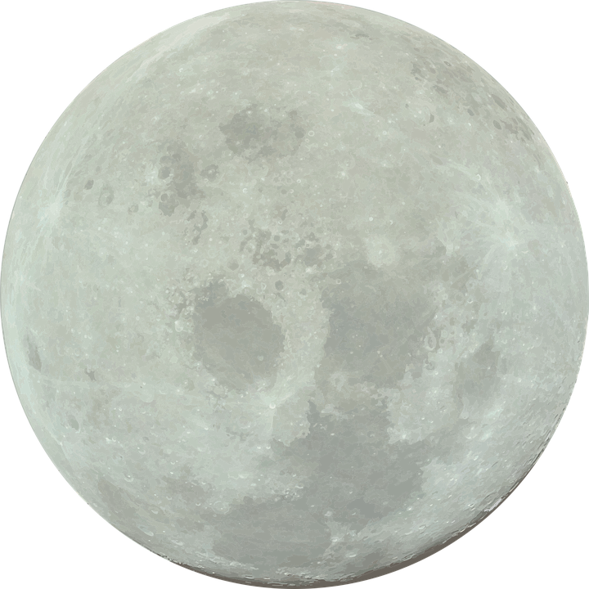

The Nature of God
Genesis 1:14-19
“Let there be lights in the firmament of the heavens...” [v14]
⬧ “...to divide the day from the night” [v14]
“...let them be for signs ” [v14]
⬧ “God made two great lights: the greater light to rule the day,
and the lesser light to rule the night” [v16, 18]
Lesser
- “He made the stars also” [v16]
The two “great lights” ‘rule’ in two ways:
1. they “give light on the earth”, making
life and work possible [cp John 9:4];
2. they “divide the light from…darkness”
to establish the presence of the kingdom
(rule) of God [cp Col 1:13; 1 Pet 2:9; etc]
Greater
Genesis 1

Slide 18
The Nature of God
“…let them be for signs”
Sometimes the Lord literally uses heavenly bodies as indicators
At other times the Lord uses heavenly bodies figuratively
“How you have fallen from heaven, O star of the morning (latin, ‘lucifer’), son of the dawn! You have been cut down to the earth, You who have weakened the nations.” Isaiah 14:12 (king of Babylon [v4] pictured figuratively as a star falling)
“...I will show wonders in the heavens and in the earth. The sun shall be turned into darkness, And the moon into blood, Before the coming of the great and awesome day of the LORD.” Joel 2:30-31 (a figure of judgment; the heavenly ‘rulers’
humbled by the presence of God; cp Joel 2:10; 3:15; Isaiah 13:10)
“The city had no need of the sun or of the moon to shine in it, for the glory of God illuminated it. The Lamb is its light.” Rev 21:23 (“New Jerusalem” figuratively governed by the light of God; cp the use of “outer darkness” in Matt 8:12; 22:13; 25:30)
Genesis 1

Slide 19
The Nature of God
Genesis 1:20-25
“Let the waters abound with an abundance of living creatures” [v20]
⬧ God decrees a filling of the earth, an abundance of creatures [vv21-22]
⬧ “...God blessed them, saying, ‘Be fruitful and multiply...’” [v22]
After creating light to dissipate the darkness [v3, vv15-18], and after organizing (ordering) His creation [vv6-10], God then fills the emptiness (void) on the earth [vv11-12; plants], in the heavens [vv14-18; sun, moon, and stars], in the sea [vv20-22], in the sky [vv20-22; birds], and also over the face of all the earth [vv24-25; creeping things, beasts, cattle]. He has resolved the three pending issues present in Genesis 1:2!
- God’s law for production and reproduction of seed “according to
its kind” is so efficient it is repeated 7 times here during the
creation of the distinct (“separate”) animal species! [vv21, 24-25]
Genesis 1

Slide 20
The Nature of God
“…according to its kind”
The Bible’s creation account does not allow for the general theory of evolution
⬧ This feels like a difficult declaration these days because “science” is so sure of itself!
- if we speak up about these things, we are ridiculed as “science deniers” or worse!
- there are a few things we would do well to remember about science:
❶ real science depends on the process of observation
- science has not created the world, but merely observes it; God
claims to speak from His position as Creator. Man is limited!
- the observer’s ‘position’, his ‘vision’ (Darwin had no microscope),
his biases and preconceived ideas might falsify his conclusions
The scientific method
a method of procedure that has characterized natural science since the 17th century, consisting in systematic observation, measurement, and experiment, and the formulation, testing, and modification of hypotheses. [Dictionary.com]
Genesis 1

Slide 21
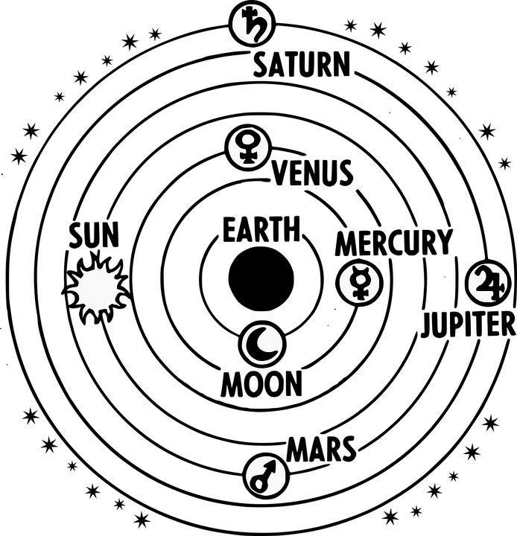
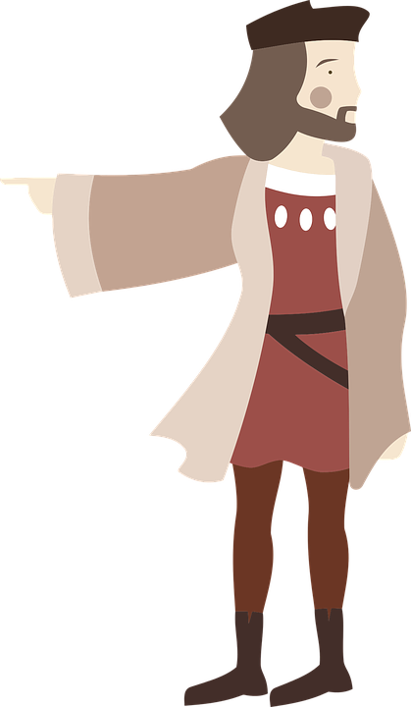


The Nature of God
“…according to its kind”
The Bible’s creation account does not allow for the general theory of evolution
⬧ This feels like a difficult declaration these days because “science” is so sure of itself!
- if we speak up about these things, we are ridiculed as “science deniers” or worse!
- there are a few things we would do well to remember about science:
❶ real science depends on the process of observation
❷ science has never been wrong
often
- give it 200 years; much of what we believe will be seen as error!
Geocentrism
reigned till
late 1500s
Columbus and others
challenged science
of their day
200 years ago no one
believed evolution; a
new theory
Genesis 1

Slide 22
The Nature of God
“…according to its kind”
The Bible’s creation account does not allow for the general theory of evolution
⬧ This feels like a difficult declaration these days because “science” is so sure of itself!
- if we speak up about these things, we are ridiculed as “science deniers” or worse!
- there are a few things we would do well to remember about science:
❶ real science depends on the process of observation
❷ science has never been wrong
often
❸ we need not fear real science, but embrace it
- the more we observe what God has made, the more we should
come to know and love Him and the beauty of His intelligence
- Isaac Newton, Johannes Kepler, Albert Einstein, and others saw
observational science as a way to draw near to the Creator
- science and the Bible are not an either/or proposition!
Genesis 1

Slide 23
The Nature of God
“…according to its kind”
The Bible’s creation account does not allow for the general theory of evolution
⬧ This feels like a difficult declaration these days because “science” is so sure of itself!
- if we speak up about these things, we are ridiculed as “science deniers” or worse!
- there are a few things we would do well to remember about science:
- since science cannot prove or disprove the existence of God, any “science” that on
principle rejects the possibility of God is foolishness [cp Rom 1:19-23]
⬧ The Bible register offers the most plausible explanations for those things that science
observes; and, while science cannot prove or disprove God, the
facts of revelation [miracles, fulfilled prophecies, etc] can!
- God does not expect us to believe based on “science” but on
“faith” – cp Hebrews 11:6; Romans 10:17
Genesis 1

Slide 24
The Nature of God
Consider what we learn of God’s nature from His account of the creation
God is ETERNAL (a uniquely Divine trait) [1:1]
God is SPIRIT (He is not physical, He is not like man) [1:2]
God’s creative power resides in HIS WORD [1:3]
God is GOOD (it is impossible for Him to think or to act by evil) [1:4]
God is HOLY (He is separate from creation; His nature is to sanctify) [1:4]
✓ God is a GOD OF ORDER (disobedience to his word brings disorder) [1:6-9]
✓ God is a GOD WHO PLANS (He made the physical creation for man before
man ever existed) [1:14; cp Eph 1:4; etc]
✓ God is LORD (He governs His creation by fixed laws)
[1:11, 21, 24; only God has the power to break the
fixed laws - the definition of miracle (cp John 3:2)]
Genesis 1

