Slide 1
“The Nature of Man”
a study of Genesis 2 for evangelism
part two:
Genesis
2:8-25

Slide 2
The Nature of Man
Genesis 2:8-14
“The Lord God planted a garden eastward in Eden...” [v8]
⬧ After making a perfect universe, God yet makes a place that is specially “set
apart” (i.e., ‘sanctified’) from the rest of creation; this place is called “Eden”
(‘Paradise’) and is where God will come for personal fellowship with man!
- This garden is, in effect, a “Holy of holies”; its aspect will be reflected in the tabernacle
and in the “New Jerusalem” described in John’s Revelation [cp Ex 26; Rev 21-22]
A VAST UNIVERSE
A “SET APART” GARDEN
ON “SET APART” EARTH
(HOLY, HOLY)
A “SET APART” (HOLY) EARTH
Genesis 2

Slide 3
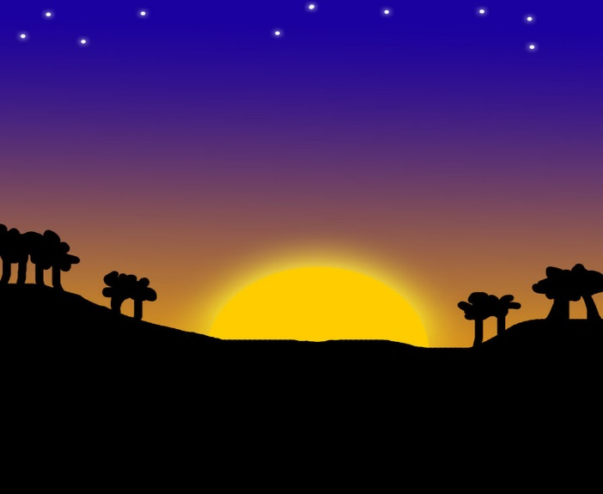
The Nature of Man
Genesis 2:8-14
“The Lord God planted a garden eastward in Eden...” [v8]
“...out of the ground the Lord God made every tree grow...” [v9]
⬧ Two aspects are emphasized: “...pleasant to the sight and good for food ”
- “good for food” is simple enough; but what purpose does a pleasant-looking tree serve?
It is a question of beauty, a sign of God’s goodness:
“...worship the Lord in the beauty of holiness.”
[1 Chronicles 16:29]
“One thing I have desired of the Lord... That I
may dwell in the house of the Lord... To behold
the beauty of the Lord...” [Psalm 27:4]
Genesis 2

Slide 4
The Nature of Man
Genesis 2:8-14
“The Lord God planted a garden eastward in Eden...” [v8]
“...out of the ground the Lord God made every tree grow...” [v9]
⬧ Two aspects are emphasized: “...pleasant to the sight and good for food ”
- “good for food” is simple enough; but what purpose does a pleasant-looking tree serve?
- “pleasant”, “good for food”, “tree of life”; God prepared for all of man’s earthly needs,
physical and emotional
Genesis 2

Slide 5
The Nature of Man
Genesis 2:8-14
“The Lord God planted a garden eastward in Eden...” [v8]
“...out of the ground the Lord God made every tree grow...” [v9]
⬧ Two aspects are emphasized: “...pleasant to the sight and good for food ”
- “good for food” is simple enough; but what purpose does a pleasant-looking tree serve?
- “pleasant”, “good for food”, “tree of life”; God prepared for all of man’s earthly needs
- “…tree of the knowledge
of good and evil...”
This tree will soon serve as a means to test man’s love and obedience
Genesis 2

Slide 6
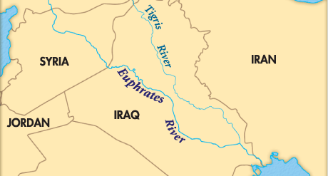
The Nature of Man
Genesis 2:8-14
“The Lord God planted a garden eastward in Eden...” [v8]
“...out of the ground the Lord God made every tree grow...” [v9]
“Now a river went out of Eden to water the garden...” [v10]
⬧ God continues to provide water for the plants – without rain!
⬧ “...it parted and became four riverheads...” [vv10-14]
• “Pishon”(?) [vv11-12]
• “Gihon”(?) [v13]
• “Hiddekel” (‘Tigris’) [v14]
• “Euphrates” [v14]
٭ BAGHDAD
God gave verifiable geographical evidence; this is not some myth, but historical fact!
• BABYLON
Genesis 2

Slide 7
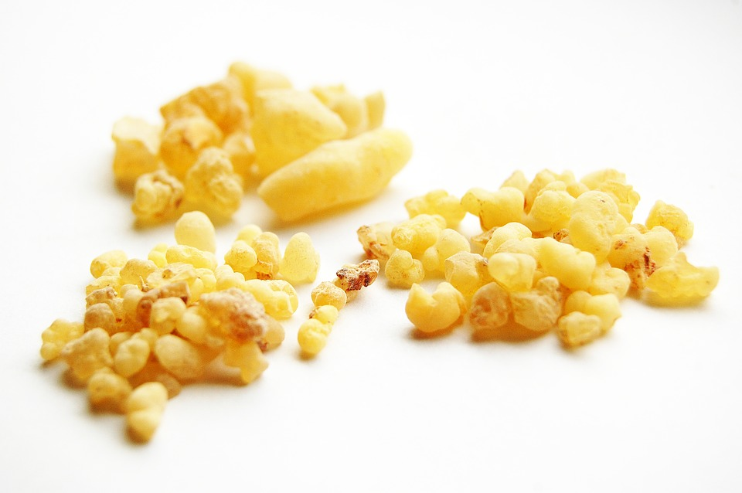
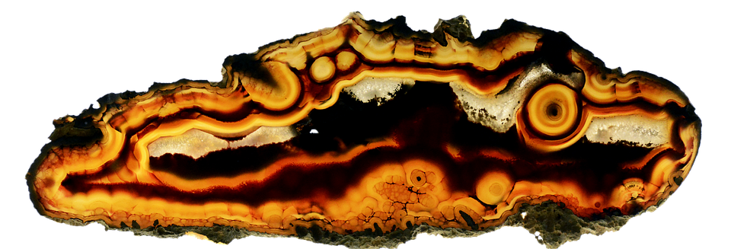
The Nature of Man
Genesis 2:8-14
“The Lord God planted a garden eastward in Eden...” [v8]
“...out of the ground the Lord God made every tree grow...” [v9]
“Now a river went out of Eden to water the garden...” [v10]
⬧ God continues to provide water for the plants – without rain!
⬧ “...it parted and became four riverheads...” [vv10-14]
• “Pishon”(?) [vv11-12]
- “...skirts the whole land of Havilah, where there is gold...” [v11]
“Bdellium and the onyx stone are there” [v12]
The next time we see all of these together again? In the tabernacle
[see Ex 25:10-40; 28:5-14; Rv 21:18]
“And the gold of that land is good.” [v12]
“Bdellium” [v12]
“onyx stone” [v12]
Genesis 2

Slide 8
The Nature of Man
Genesis 2:15-17
“...the Lord God...put him in the garden...to tend and keep it” [v15]
⬧ “Tend” and “keep” is a much lighter work than “till” [v5] and “plant”; God
gave man a prepared paradise that only needs appropriate maintenance
The Garden of Eden is the absolute standard for the rest that awaits the faithful:
Notice how God uses this idea in other places…
The Promised Land: “…beautiful cities…houses full…hewn-out wells…vineyards…
olive trees…”; they received all of this from God, but they did
no work! [Dt 6:10-12; cp also Joshua 24:13]
The Heavenly ‘Mansion’: “In My Father’s house…I go to prepare
a place for you” [John 14:1-6]
The Heavenly Rest: “he who has entered His rest has himself also
ceased from his works…” [Hb 4:10; Rv 14:13]
Genesis 2

Slide 9
The Nature of Man
Genesis 2:15-17
“...the Lord God...put him in the garden...to tend and keep it” [v15]
“...God commanded...‘Of every tree...you may freely eat’” [v16]
⬧ God begins by giving a very generic law – “freely eat!” [cp John 8:32 “free”]
- God tempers His generic law with a very specific one: “...of the tree of the knowledge
of good and evil you shall not eat...” [v17]
- Generic laws may be fulfilled in any way that does not violate the law itself; however,
specific laws must be obeyed exactly as revealed
– as such, specific laws often contain consequences or punishment
in the case that they are not obeyed: “for in the day that you eat
of it, you shall surely die.” [v17]
Genesis 2

Slide 10
The Nature of Man
Genesis 2:15-17
“...the Lord God...put him in the garden...to tend and keep it” [v15]
“...God commanded...‘Of every tree...you may freely eat’” [v16]
⬧ God begins by giving a very generic law – “freely eat!” [cp John 8:32 “free”]
- God tempers His generic law with a very specific one: “...of the tree of the knowledge
of good and evil you shall not eat...” [v17]
No! They’re quite simple
!!!
Are God’s laws here hard to understand?
Again, NO!!
Was God testing Adam’s intelligence?
Genesis 2

Slide 11
The Nature of Man
Genesis 2:15-17
“...the Lord God...put him in the garden...to tend and keep it” [v15]
“...God commanded...‘Of every tree...you may freely eat’” [v16]
⬧ God begins by giving a very generic law – “freely eat!” [cp John 8:32 “free”]
- God tempers His generic law with a very specific one: “...of the tree of the knowledge
of good and evil you shall not eat...” [v17]
God’s word is a test of man’s love and obedience
• As Creator, He creates and maintains order by means of His word
• Disorder in the world is the result of disobedience to God’s orders
• God’s word was not meant to be difficult for man to comprehend
• In obeying or disobeying we reveal whether we love God or not
“God is testing you to know whether you love the Lord” [Dt 13:3]
“If you love Me, keep My commandments” [John 14:15; 2 John 6]
Genesis 2

Slide 12
The Nature of Man
Genesis 2:18-20
“...the Lord God said, ‘It is not good that man should be alone’” [v18]
⬧ This “not good” is a shocking declaration in the context of a creation about
which God has seen “indeed it was very good” [Gn 1:31]
- First: note that this declaration is not the reaction of God concerning some situation
that was poorly resolved during creation; we are still in the context of the sixth day
(the creation of man - Gn 1:26-28), after which He declared that all was “very good”
- Second: this is not a case of “loneliness”, but of “aloneness”: God, in His eternal wisdom,
determines that it is not good for man to be “alone”, and so creates
“a helper comparable to him” [v18]
• not even God is alone ; cp “Us” in Gn 1:26-27 [cp Eph 5:31-32]
• the woman is God’s answer to this need (not another man, etc)
• the woman was made with a purpose: “a helper comparable”
Genesis 2

Slide 13
The Nature of Man
Genesis 2:18 Woman: the “helper comparable”
From the moment of her creation...
Woman was made, in God’s wisdom, to fulfill the role of helper
Unfortunately, man’s “wisdom” ridicules and despizes woman’s God-given role...
- some despize the woman’s role by treating her as a slave or in some way as inferior
- some despize her role by trying to make it “equal” or “superior” to the man’s role
Neither of these two approaches pleases God!!
Genesis 2

Slide 14
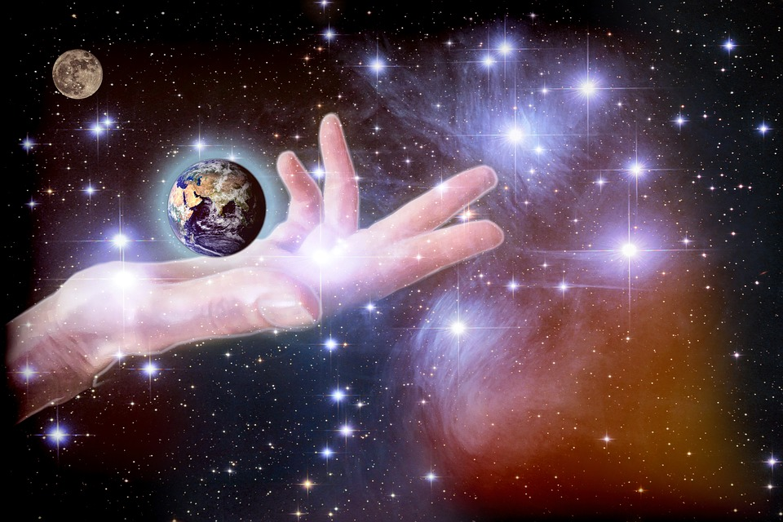
The Nature of Man
Genesis 2:18 Woman: the “helper comparable”
From the moment of her creation...
Woman was made, in God’s wisdom, to fulfill the role of helper
Woman was made, in God’s wisdom, as someone comparable
She was made perfectly to fit what the man is and what he needs to fulfill his role
- having a different role does not make someone “ridiculous” or “despicable”...
Who of these is despicable or worthless...?
God designed the universe...
Jesus died on a cross...
The Spirit revealed it all...
Genesis 2

Slide 15
The Nature of Man
Genesis 2:18 Woman: the “helper comparable”
From the moment of her creation...
Woman was made, in God’s wisdom, to fulfill the role of helper
Woman was made, in God’s wisdom, as someone comparable
We must revise how we think about “servants” or “helpers” and not think as the “Gentiles” do! A servant is defined by service; a helper is defined by helping!
She was made perfectly to fit what the man is and what he needs to fulfill his role
- having a different role does not make someone “ridiculous” or “despicable”...
Was Jesus’ role as servant despicable? He didn’t think so!
- being a “helper” or servant does not make someone “ridiculous” or “despicable”...
“You know that those who are considered rulers over the Gentiles lord it over them, and their great ones exercise authority over them. Yet it shall not be so among you; but whoever desires to become great among you shall be your servant. And whoever of you desires to be first shall be slave of all. For even The Son of Man did not come to be served, but to serve, and to give His life a ransom for many.” [Mark 10:42-45]
Genesis 2

Slide 16
The Nature of Man
Genesis 2:18-20
“...the Lord God said, ‘It is not good that man should be alone’” [v18]
God brought the animals to see what Adam “would call them” [v19]
⬧ Note that God is not creating the animals in response to Adam’s aloneness;
they had already been created on the 5th and 6th days [Gn 1:20-25]
- God bringing the animals before Adam allows him to exercise a part of his God-given
role of “dominion” [Gn 1:26-28; note that “naming” is also another “likeness” to God!]
- God bringing the animals to Adam impresses upon him the fact that they cannot fulfill
his need: “there was not found a helper comparable to him” [v20]
• animals cannot reason and plan together with Adam to the end
of fulfilling God’s will in his life…
• armed with this information, Adam is now ready for a helper
Genesis 2

Slide 17
The Nature of Man
Genesis 2:21-25
“...the Lord God caused a deep sleep to fall on Adam...” [v21]
⬧ God performs the first ‘surgery’: removing one of Adam’s ribs, closing up
“the flesh in its place” [v21], and making that rib “into a woman” [v22]
Why would God have made the woman from a rib?
Popular thinking:
Not from the head, so she won’t feel superior to the man...
From a rib, so that they won’t forget they are equals before God and therefore should walk side by side...
Not from the foot, so the man won’t feel superior to her...
Perhaps... however:
Genesis 2

Slide 18
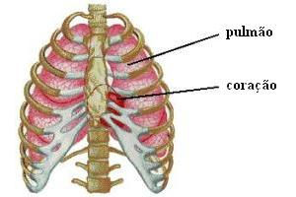
The Nature of Man
Genesis 2:21-25
“...the Lord God caused a deep sleep to fall on Adam...” [v21]
⬧ God performs the first ‘surgery’: removing one of Adam’s ribs, closing up
“the flesh in its place” [v21], and making that rib “into a woman” [v22]
Why would God have made the woman from a rib?
In this way, the woman who fulfills her role well protects the man’s vitality:
lungs
heart
“The heart of her husband safely trusts her...”
[Proverb 31:11]
“Her husband is known in the gates, when he
sits among the elders of the land.” [Pv 31:23]
“Her husband...praises her: ‘Many daughters
have done well, But you excel them all.’”
[Proverb 31:28-29]
The role of ribs is the protection of a man’s vital organs!
Genesis 2

Slide 19
The Nature of Man
Genesis 2:21-25
“...the Lord God caused a deep sleep to fall on Adam...” [v21]
“He brought her to the man. And Adam said...” [vv22-23]
⬧ God brings the woman before Adam just as He had done with the animals;
this time, however, Adam’s reaction would be very different! [v23]
- Adam perceives that the woman is exactly what was lacking; she is what he needed!
- having named all the animals, he can now see her great superiority – she is like him!
So...he gives her a name – HIS OWN NAME! [he is “iysh”; he calls her “ishshah”]
Even today, this practice continues in our culture: when we get married, the wife takes the name of her husband!
Genesis 2

Slide 20
The Nature of Man
Genesis 2:21-25
“...the Lord God caused a deep sleep to fall on Adam...” [v21]
“He brought her to the man. And Adam said...” [vv22-23]
“Therefore, a man shall leave his father and mother...” [v24]
- Who said these words?
When first reading, it looks like Adam said this, which would be very strange seeing as he had no father or mother...
In the New Testament, when some Pharisees challenge Jesus regarding divorce, He says: “Have you not read that He who made them at the beginning ‘made them male and female,’ and said, ‘For this reason a man shall leave his father and mother and be joined to his wife, and the two shall become one flesh’?” [Mat 19:4-5]
Genesis 2

Slide 21
The Nature of Man
Genesis 2:21-25
“...the Lord God caused a deep sleep to fall on Adam...” [v21]
“He brought her to the man. And Adam said...” [vv22-23]
“Therefore, a man shall leave his father and mother...” [v24]
⬧ “…and be joined to his wife, and they shall become one flesh.” [v24]
These words are God’s commentary on marriage
• All marriages from this one forward should follow the same pattern
• God’s design for marriage as seen in this example follows this plan:
(1) One woman and one man (any other combination is illicit);
(2) Leave father and mother (a new primary family relationship);
(3) Become one flesh (they should be inseparable except by death)
The plan established in Gen 2 is cited by God in the whole Bible as the law of marriage [Mal 2:13-16; Eph 5:30-32; 1 Cor 6:16-18; etc]
Genesis 2

Slide 22
The Nature of Man
Genesis 2:21-25
“...the Lord God caused a deep sleep to fall on Adam...” [v21]
“He brought her to the man. And Adam said...” [vv22-23]
“Therefore, a man shall leave his father and mother...” [v24]
⬧ “…and be joined to his wife, and they shall become one flesh.” [v24]
- “one flesh” describes a perfect union – she is just what the man needed!
There are two inherent aspects to this union: (1) unity of purpose, which is the real goal of any relationship, and (2) physical union, which, in the sinless paradise of Eden was not accompanied by any reason whatsoever for them to sense a shadow of shame. In fact, shame at their nudity and division are the first visible signs of the effects of sin on their lives in Genesis 3...
Genesis 2

Slide 23
The Nature of Man
“and they shall become one flesh”
In the perfection of Eden’s paradise,
where God had provided for all of man’s phyiscal and emotional needs...
God created marriage to illustrate perfectly His intimate desire for us:
Would you fulfill God’s desire to bring you to Himself in Jesus, His Son?
Rev 19:6-9
These words are God’s commentary on marriage:
“Wives, submit to your own husbands, as to the Lord… Husbands, love your wives, just as Christ also loved the church and gave Himself for her… For no one ever hated his own flesh, but nourishes and cherishes it, just as the Lord does the church. For we are members of His body, of His flesh and of His bones. ‘For this reason a man shall leave his father and mother and be joined to his wife, and the two shall become one flesh.’ This is a great mystery, but I speak concerning Christ and the church.”
[Ephesians 5:22-32]
Genesis 2

